Slide 1

Team Name: Agneyam
Indigenous Design and Fabrication of 6U CubeSat with micro propulsion system and a Broadband spectrometer Payload for Soil Carbon mapping and climate modelling system
Problem Statement: AI-Based Soil Carbon Sequestration Optimization System
Name of the Startup: Agneyam Aerospace Labs, Chennai.
Udyam Reg No: Udyam-TN-08-011-0118821.
Founder & CEO: R. Prithivirajan (Hardware Head).
Co-Founder & Co-CEO: S. Naveenkumar.
Members & Partners: Praveen VP (Software), Praveen Abraham. P (CAD) & Sachin J (Hardware assist)
Incubation cell: Incubated at Sathyabama Startup Cell.
Official ISRO (InSpace) user name: Agneyam@2006
Fund Raised so far: 1. equipment support for R&D from Sathyabama Innovation council and startup cell.
Introduction: Nano satellite lack Indigenous design and fabrication in INDIA, cannot be used for interplanetary mission and traditional nano IR spectrometer payload are limited to detect only a specific band in Spectrum not a wide band. So, the task is to develop a CubeSat with micro-propulsion and broadband spectrometer payload for remote sensing, agriculture monitoring, military application, climate studies.

Slide 2
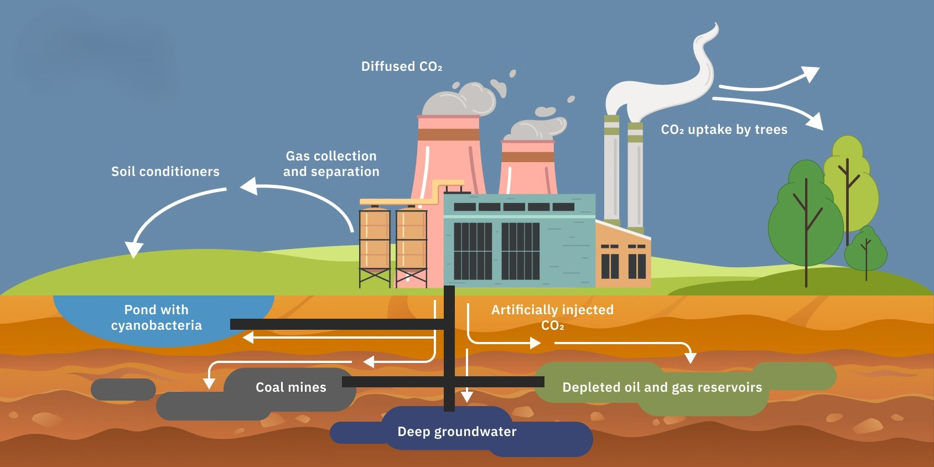
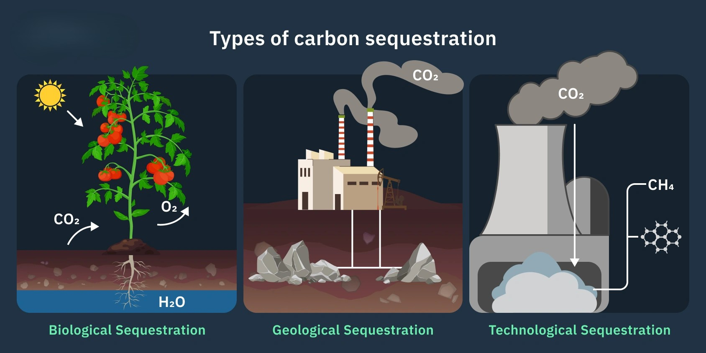
PROBLEM STATEMENT.
Clear Explanation of the Problem
Atmospheric CO₂ levels have significantly increased due to industrialization and unsustainable land practices, accelerating global warming. Although soil is a major carbon sink, there is no scalable system to continuously monitor and optimize soil carbon sequestration.
Who is Affected?
Farmers, governments, environmental agencies, and carbon credit markets are directly impacted due to the lack of reliable carbon data. This also affects global climate mitigation efforts and sustainable agriculture planning.
Why is this Problem Important?
Soil stores more carbon than the atmosphere and vegetation combined, making it crucial for climate regulation. Without proper monitoring and management, degraded soils release stored carbon, worsening climate change.
Current Limitations / Gaps in Existing Solutions
Existing solutions rely on manual soil sampling, which is expensive, slow, and geographically limited. There is no AI-powered, satellite-integrated system that predicts soil carbon potential and provides sustainability recommendations at scale.

Slide 3
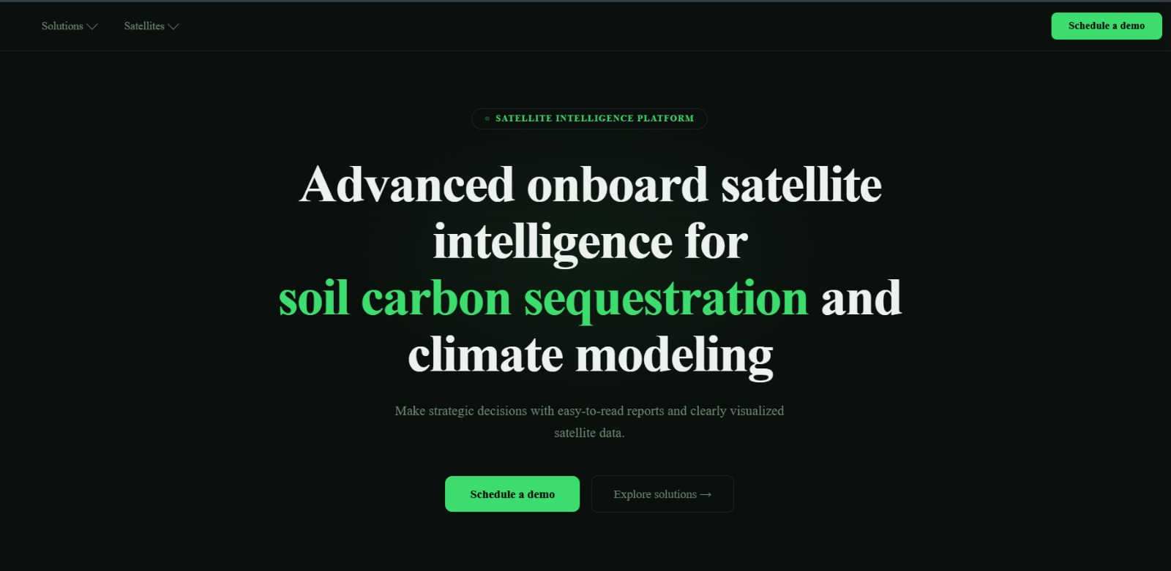
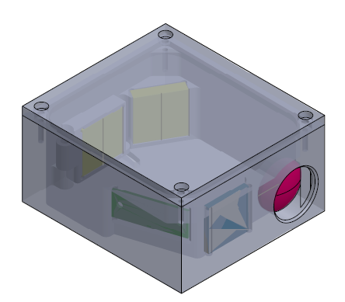
IDEA
& APPROACH
Idea: Indigenous Design and Fabrication of 6U CubeSat with micro propulsion system and a Broadband spectrometer Payload for Soil Carbon mapping and climate modelling system
Proposed solution:
Root Cause of the problem:
Environmental Impact Visualization Dashboard with geo-referenced carbon maps.
Comparative Carbon Gain Analysis across districts / states.
Patented Self Powered Broadband IR spectrometer (Near-
IR – Far-IR) (900nm to 5000nm).
Palm Sized Pulsing Micro propulsion system using Hypergolic fuel (Using low sulphur kerosene and H2O2) for orbit slingshot.
Multiple satellite for each Data results in high cost
Propulsion system with less specific impulse.
Absence of broad band IR detector.
Traditional Engine material undergoes oxidation and crack under harsh environmental condition.
AI based Predictive system
Innovation & Uniqueness:
How it addresses the problem:
Color mapping for easy visualization
Comparative methods for easy Prediction and analysis
Use of Promoter in gelled purified low sulphur kerosene with GONPs aerogel as gellant and AgPtNPs catalyst and H2O2
Mercury Cadmium Telluride (MCT), IR detector
Use of Optical bandpass filter in spectrometer payload to eliminate unwanted radiation in space environment.
Graphene based High density battery.
Conventional spectrometers limited to specific bands (visible, NIR, or MIR) preventing comprehensive analysis.
Traditional Propulsion system has lower specific impulse.
Problem in larger Data transmission within the Signal Window.
Traditional Satellite cannot do onboard analysis resulting in ground station analysis setup.
Palm sized Broadband IR spectrometer
3
Notes:
3

Slide 4
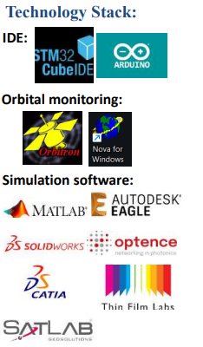

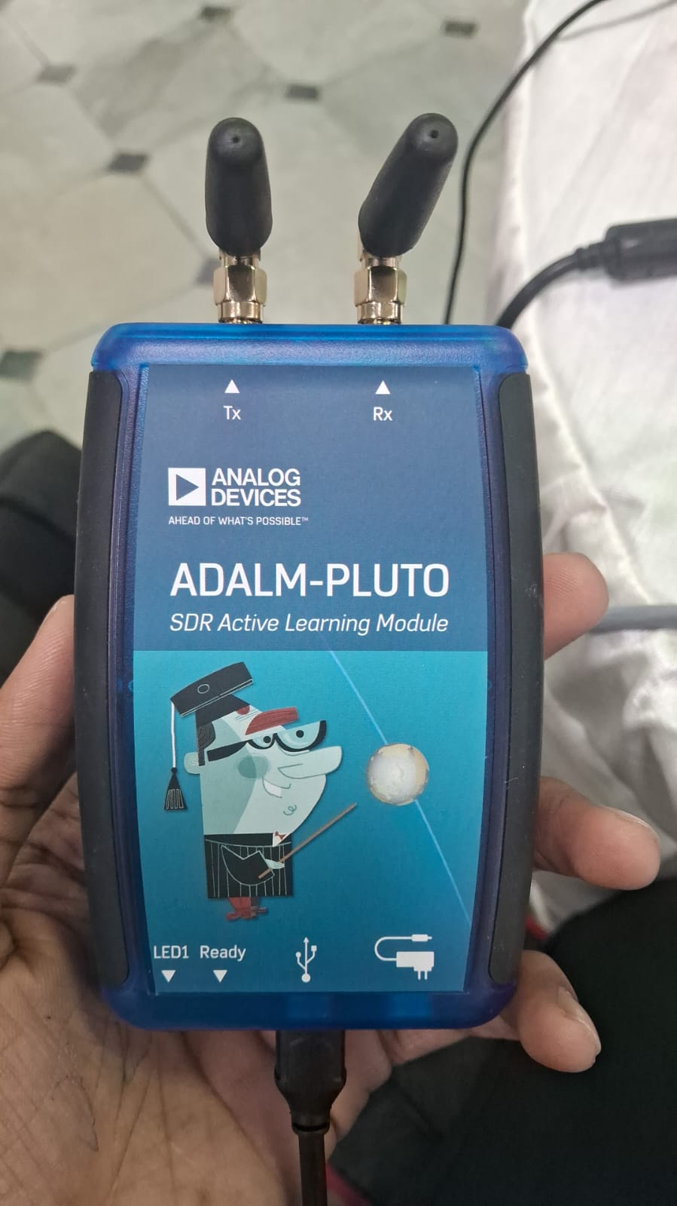
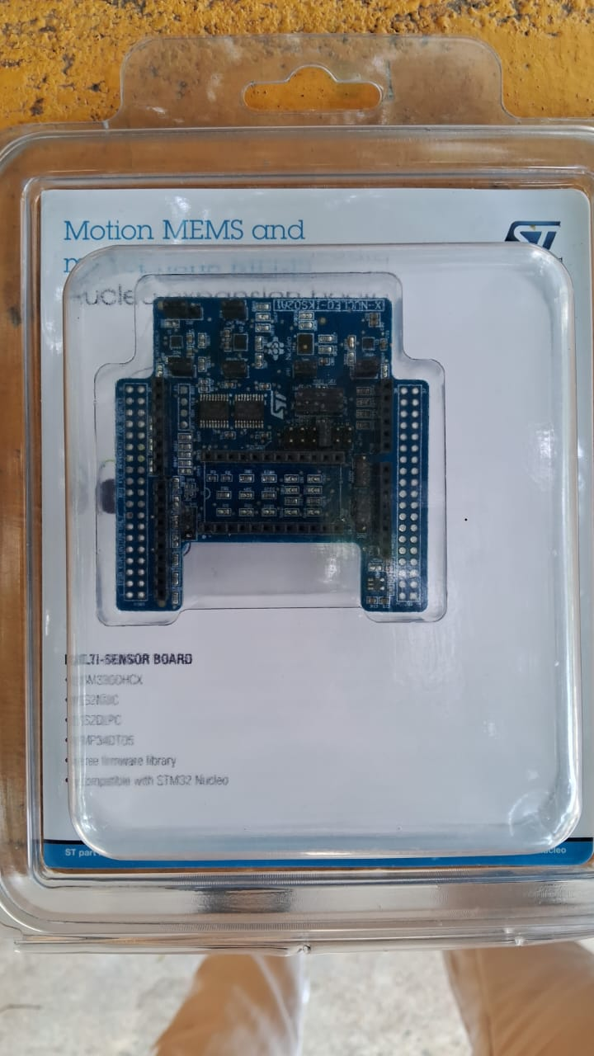
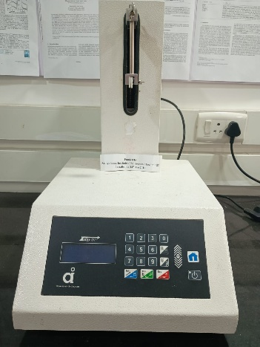
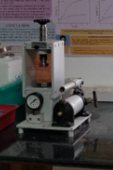
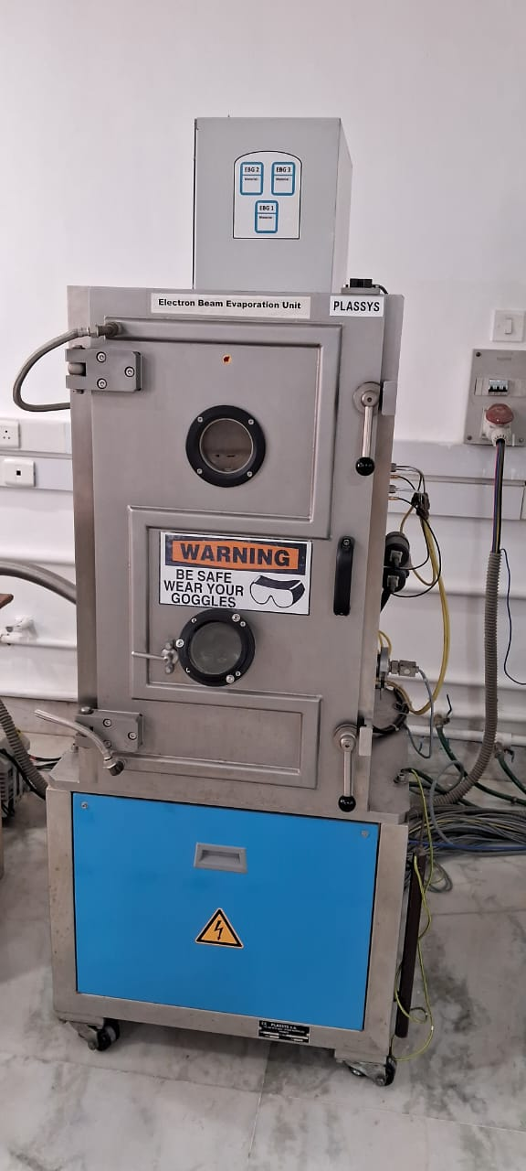
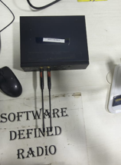


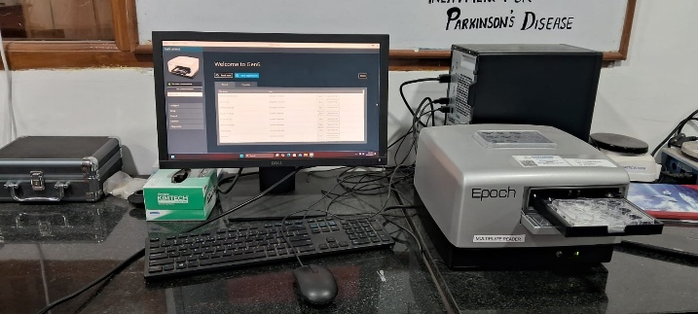
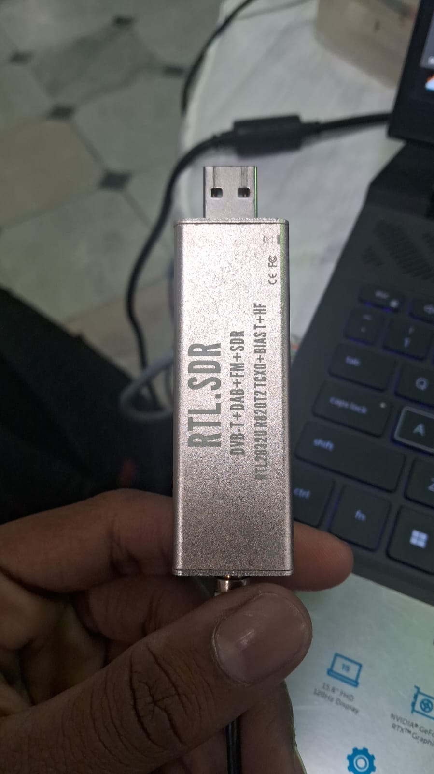
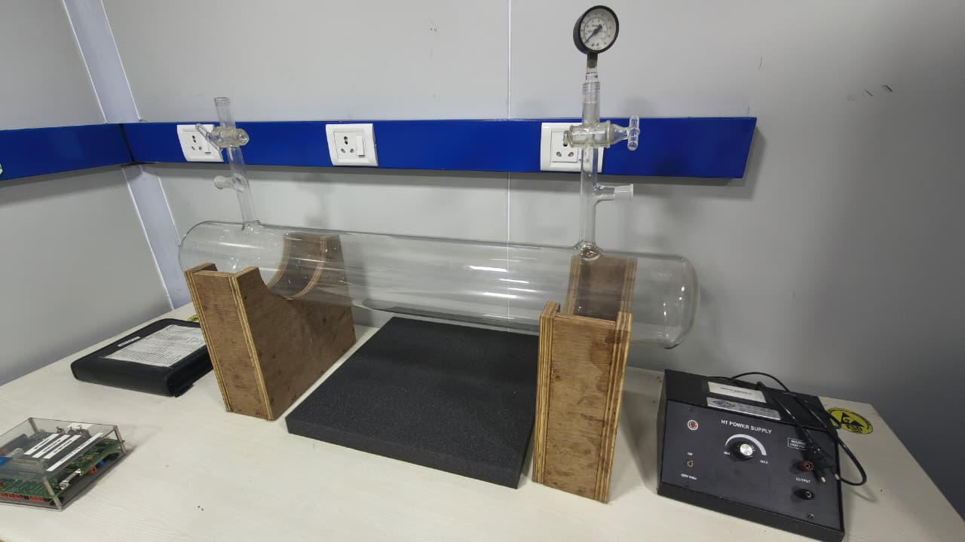
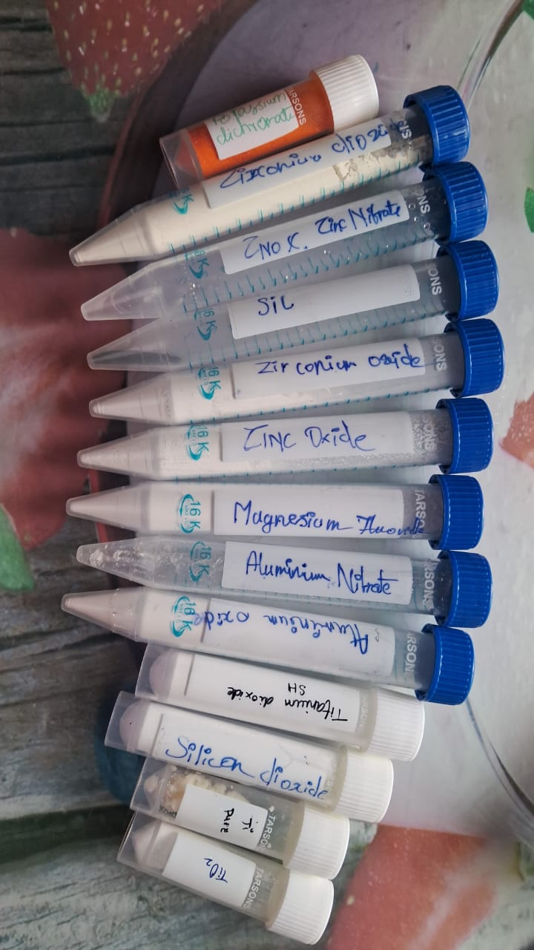
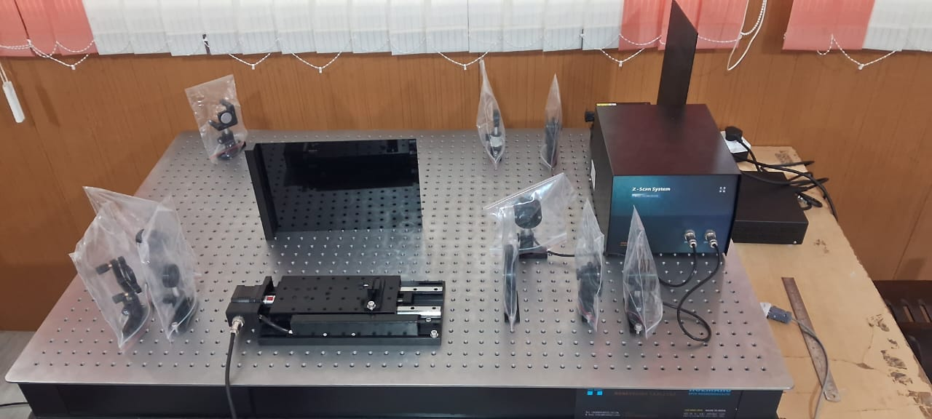
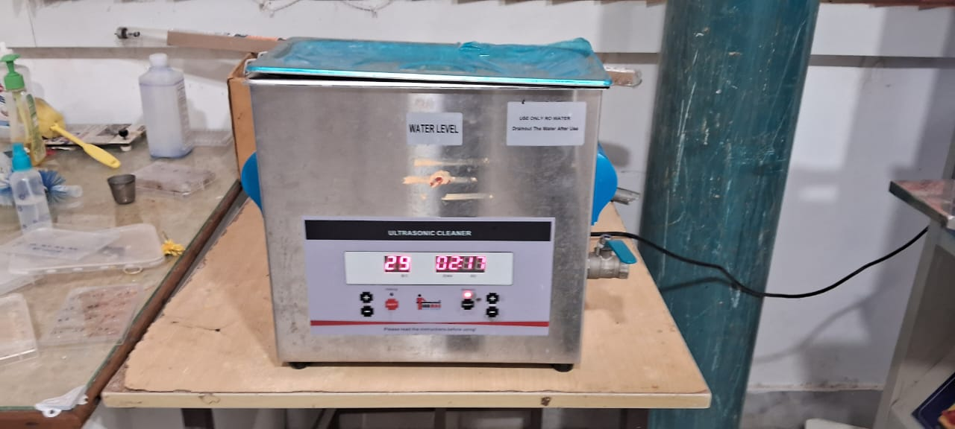

Tech Stack
Hardware Used:
Tensile strength tester
DIP coating
Optical density machine
PVD machine
Semiconductor used :
laser interferometer
Vacuum calibration tube
Ultra sound Cleanser
4
4
Notes:
4

Slide 5
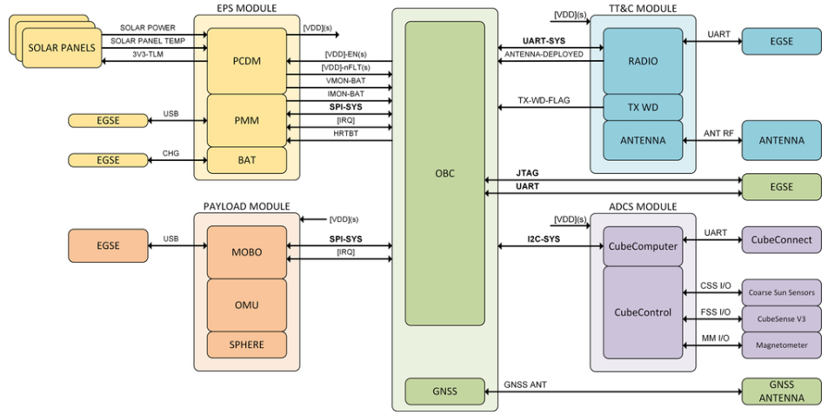
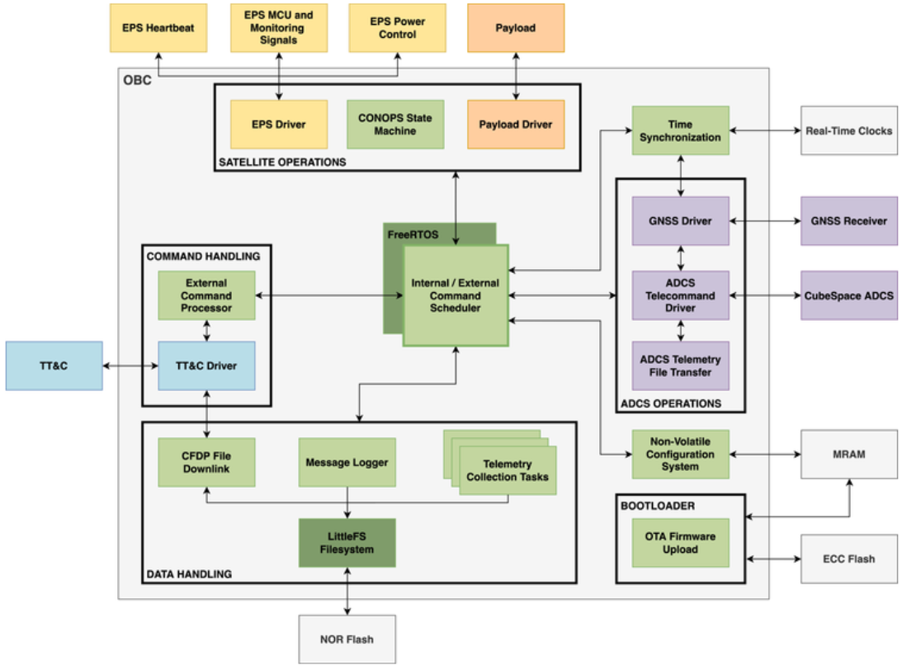
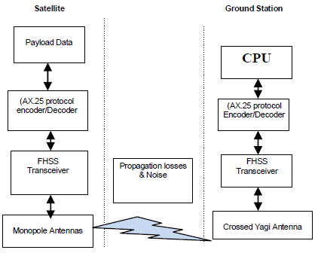
System Architecture
Software work flow:
Hardware work flow:
RF communication protocol:
5
5
Notes:
5

Slide 6
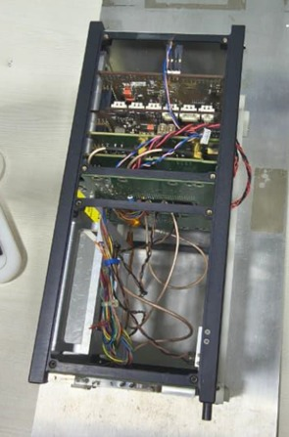
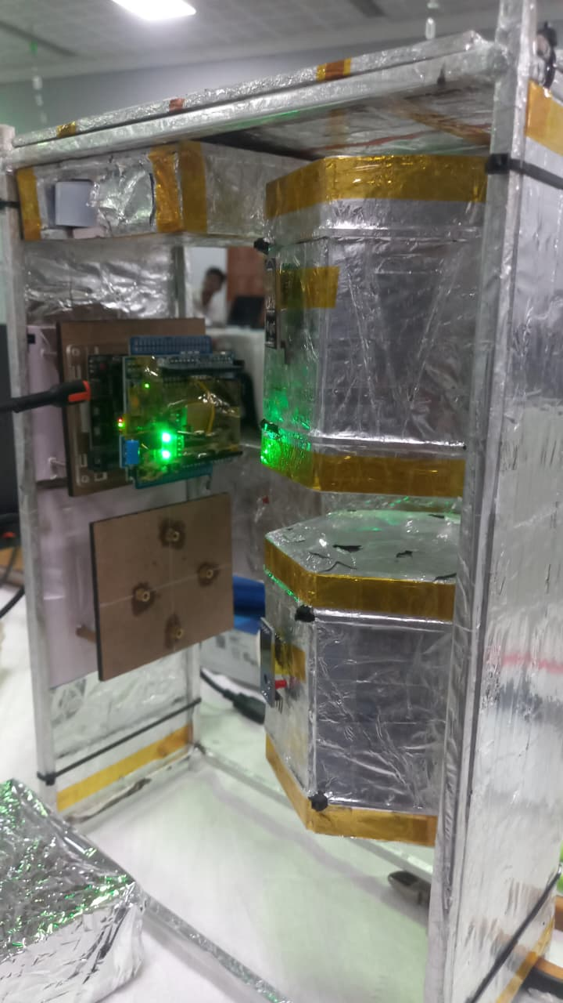
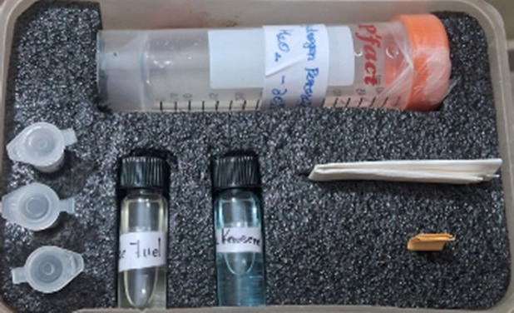
Innovation and Uniqueness
Innovation:
Unlike conventional AI soil carbon systems that rely on ground surveys, lab samples, or secondary datasets, our project introduces direct satellite-based soil carbon sensing using a broadband IR spectrometer (900–5000 nm).
Development of a patented self-powered broadband IR spectrometer covering Near-IR to Far-IR, which is not available in traditional CubeSat payloads.
Integration of an AI-based predictive analytics system directly with satellite payload data.
Generation of geo-referenced carbon maps using satellite-captured IR data combined with AI analytics.
Design of a palm-sized pulsing micro-propulsion system using hypergolic fuel (low-sulphur kerosene + H₂O₂).
Complete indigenous design and fabrication aligned with Make-in-India and IN-SPACe vision.
Original Model in
Clean room Facility
Working Project
Prototype
6

Slide 7
Conclusion
The project presents an indigenous 6U CubeSat integrated with a broadband IR spectrometer, micro-propulsion system, and AI-based predictive engine to enable accurate soil carbon mapping and climate modelling from space.
Using a 900–5000 nm broadband spectrometer with MCT detectors and AI analytics, the system directly captures soil carbon spectral signatures and generates predictive carbon sequestration insights with high precision.
The solution supports climate change mitigation, sustainable agriculture planning, soil health monitoring, and carbon credit verification, contributing toward national sustainability and net-zero goals.
It can be deployed for government climate programs, research institutions, precision farming initiatives, and district/state-level environmental monitoring through geo-referenced carbon mapping and comparative analysis dashboards.
The platform can be expanded into a CubeSat constellation, enhanced with real-time onboard AI processing, extended spectral capabilities, and integrated ground validation systems to create a nationwide soil carbon intelligence network.
7

